Slide 1
How to set up and to use a printer or a scanner
By: Elizabeth Hadley

Slide 2
Objective:
I CAN set up a printer and/or a scanner and can teach others how to.

Slide 3
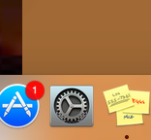
STEP1
go to your dock and click on System Preferences

Slide 4
STEP 2
Go to the second row of your preferences and click on printers and scanners

Slide 5
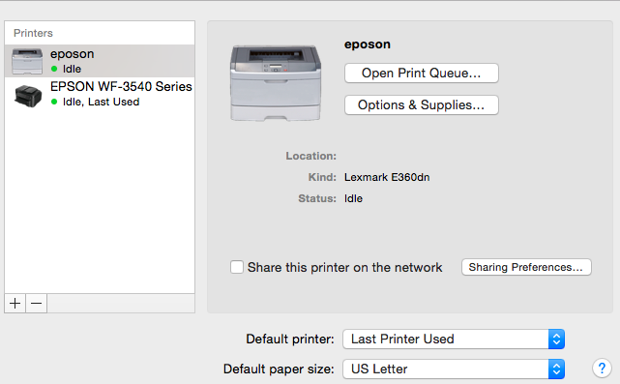
STEP 3:
When you click on it, you usually will see normal settings. Then you click on the plus sign in the bottom left corner.

Slide 6
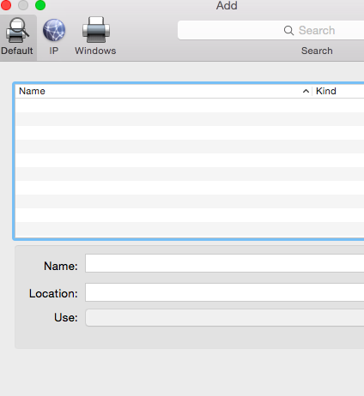
Step 4:
Once you have clicked on the plus sign this should appear

Slide 7
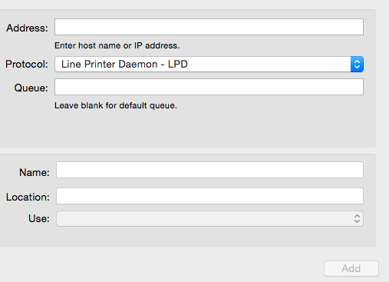
STEP 5:
Then click on the icon called i.p. then it will pull up the information boxes you need to connect to a printer/scanner

Slide 8
Remember:
You need to be near a printer/scanner to be able to connect to it.
OR THE spinning beach ball of death

Slide 9
SO DO YOU KNOW?
What do you click to add a printer to use?
The plus sign
Where do you go to connect to a printer/scanner?
System preferences

Slide 10
The end

